Slide 1

Exploring Popularity in Music: A Capstone
A Social Media Text Mining and Sentiment Analysis Project

Slide 2

What does “liking,” “sharing,” “posting,” and “commenting” mean in the bigger picture?

Slide 3
Activities Constructing “Value”
Public commenting and validating processes
Expressing “belonging” or “non-belonging”
Participating in popular culture—a context for defining and announcing value
Participating in the life of music —where the social construction of value operates

Slide 4
Research Question:
What is the relationship between social media user activity and popularity? How do sentiments communicate social value?

Slide 5
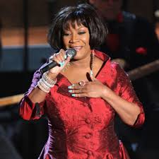
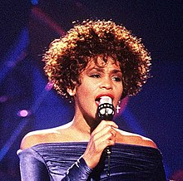
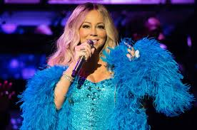



R&B Singers and Their Popularity

Slide 6
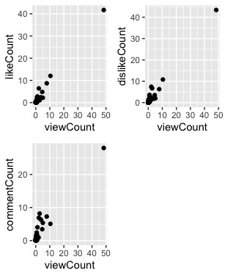
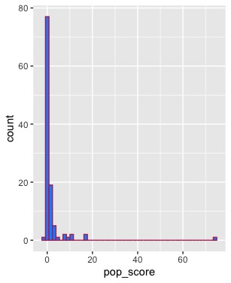
Exploratory Data Analysis

Slide 7
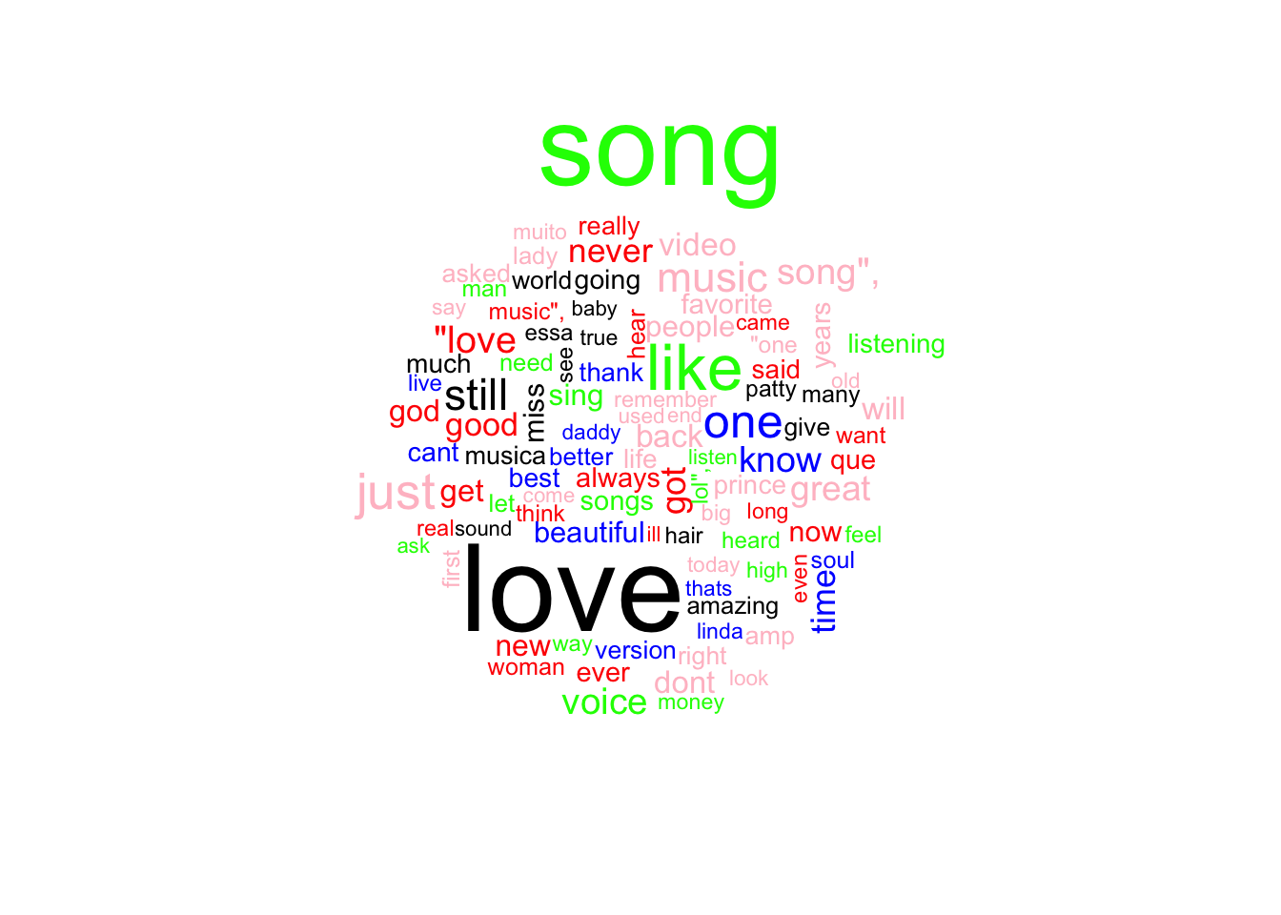
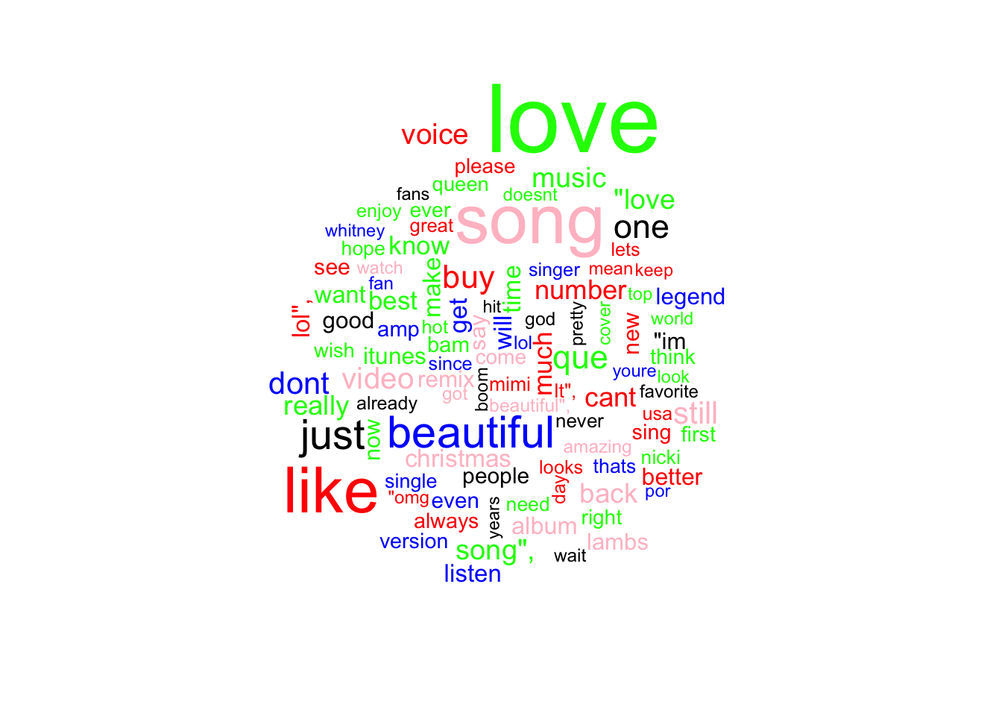
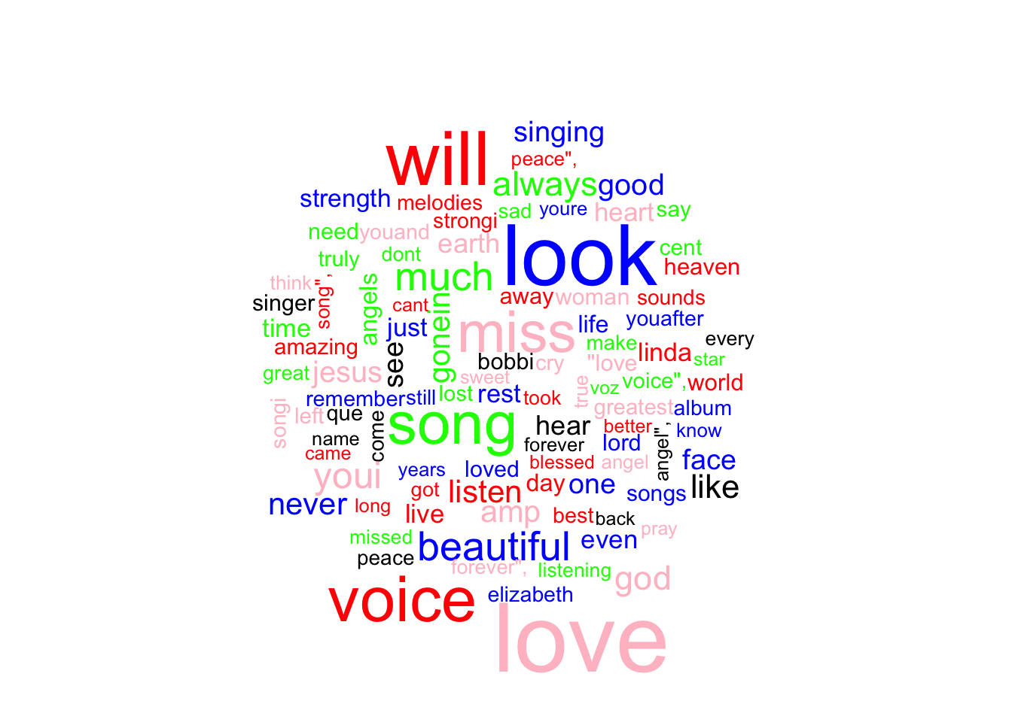
Deeper Dive into the Data:
Natural Language Processing
Patti LaBelle Word Cloud
Mariah Carey Word Cloud
Whitney Houston Word Cloud

Slide 8
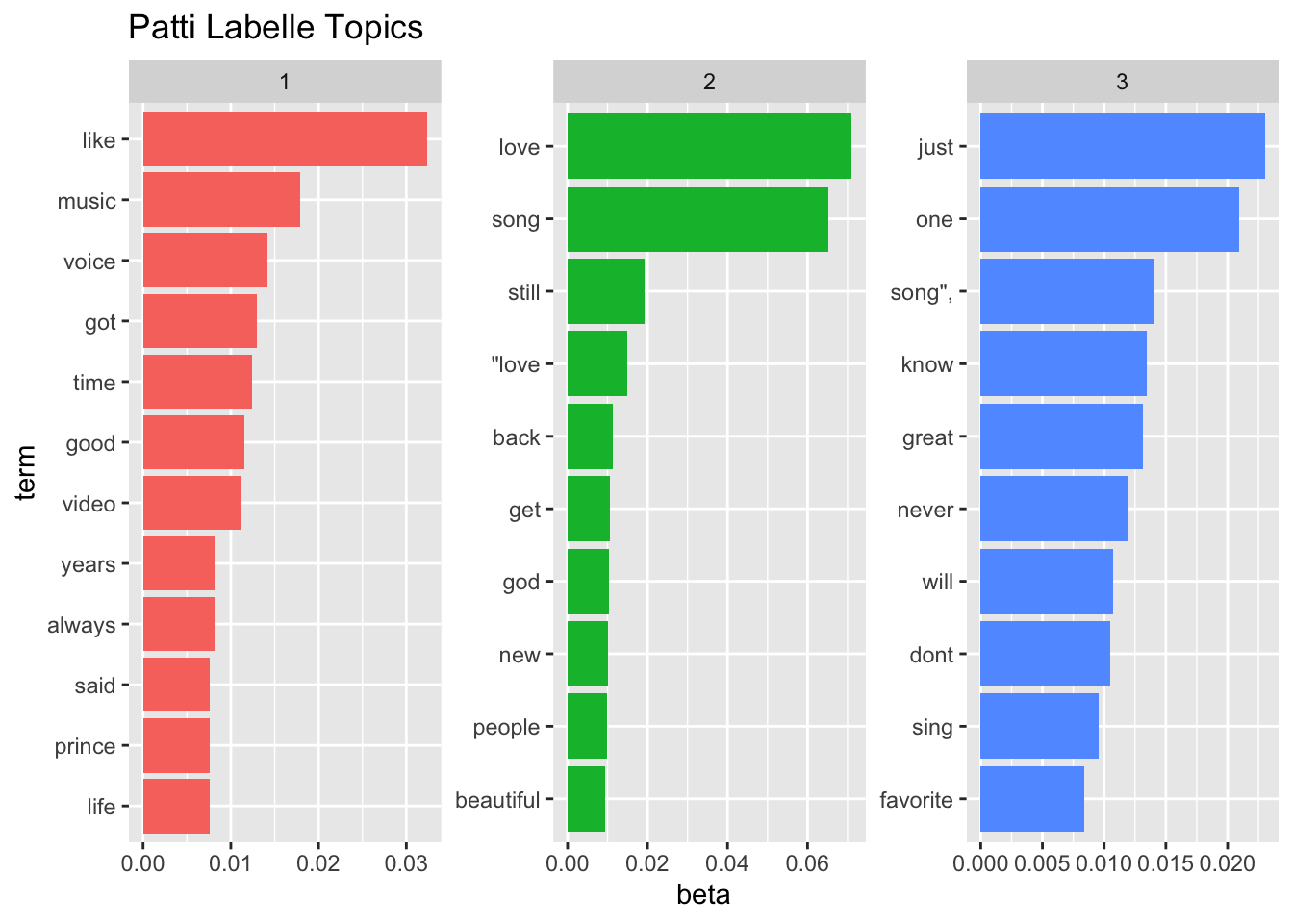
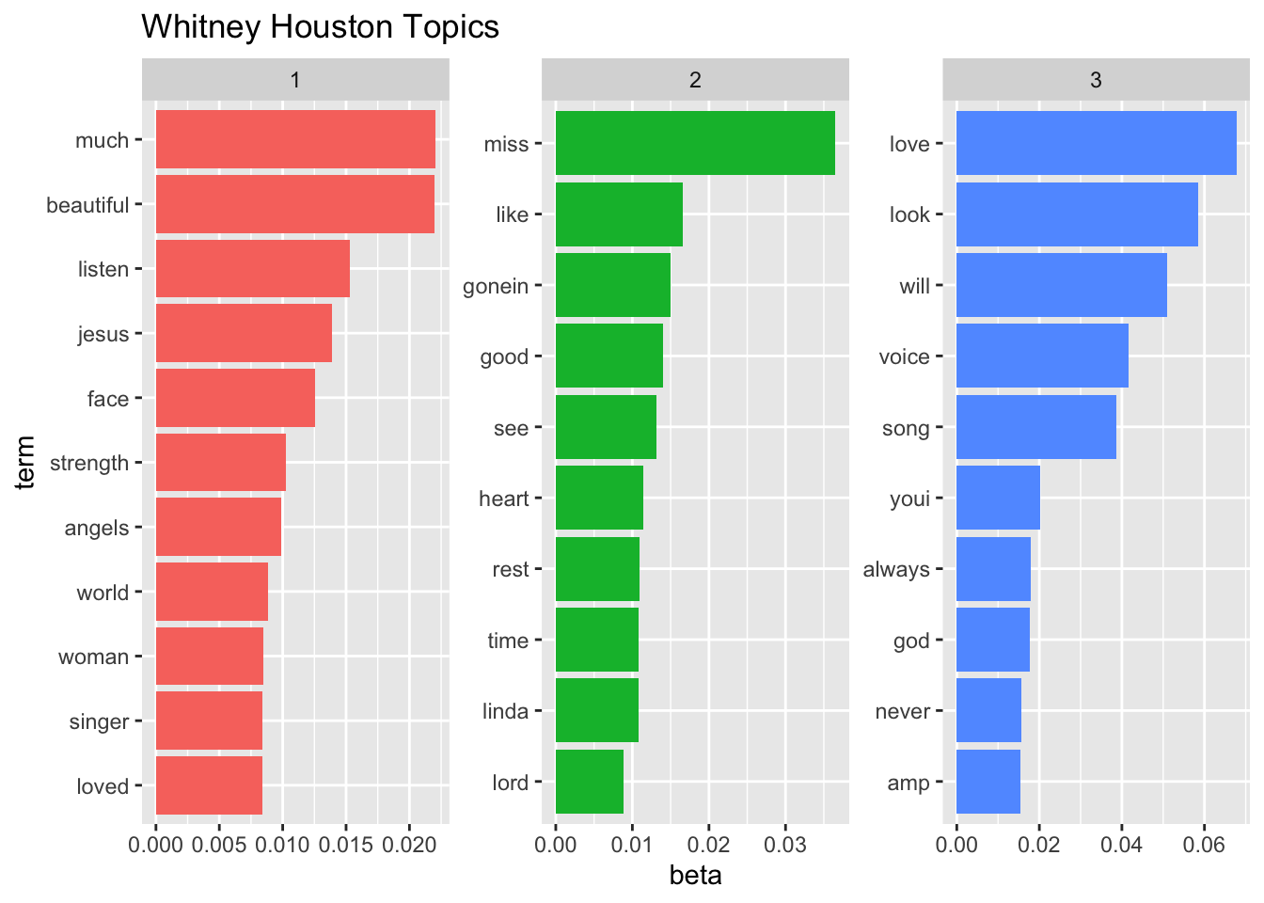
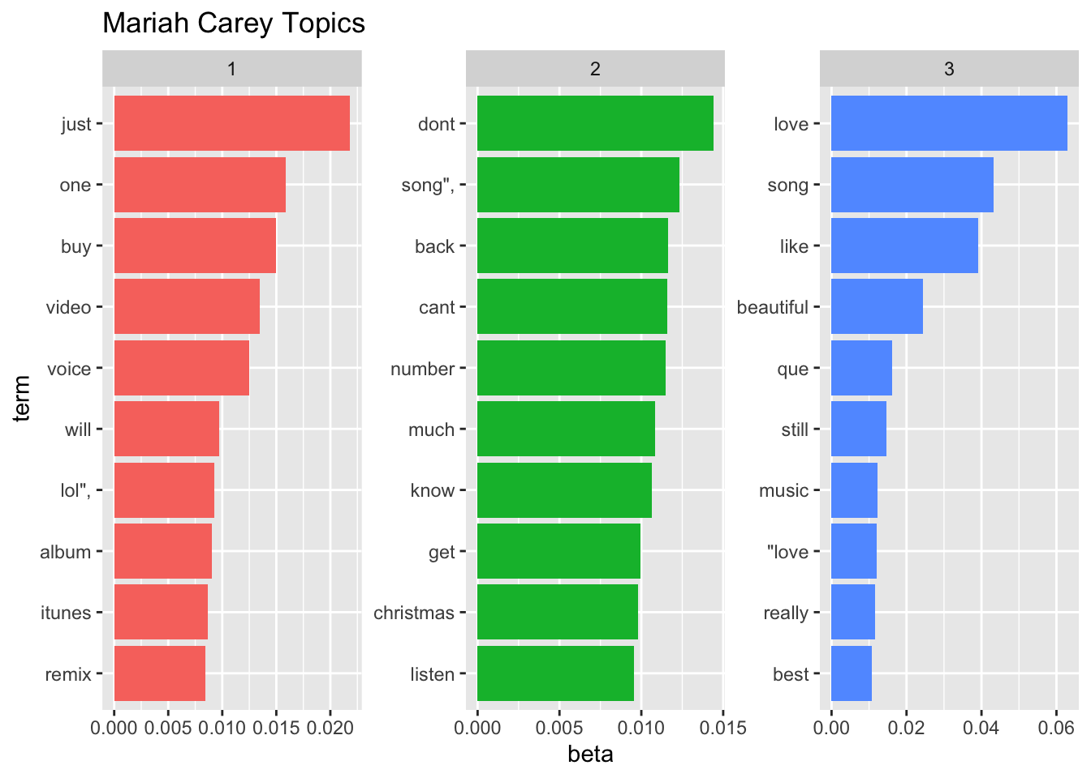
Topic Modeling

Slide 9
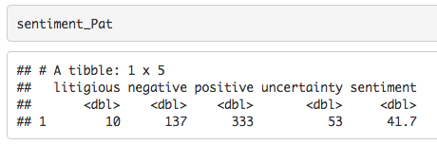
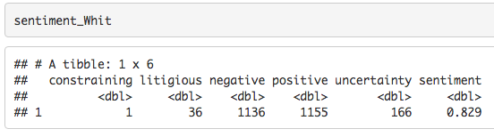

Sentiment Analysis

Slide 10
The View of Popularity From Text Analytics:
Bigness and Timelessness
Transcendence and Immanence
Legendary Status Within Contemporary World

Slide 11
Any Questions?

Slide 12
Thank You

